Slide 1
TRUTH TABLE BY
SAGHAR ZARE

Slide 2
Truth table
A truth table is a mathematical table used in logic—specifically in connection with Boolean algebra, boolean functions, and propositional calculus—which sets out the functional values of logical expressions on each of their functional arguments, that is, for each combination of values taken by their logical variables (Enderton, 2001). In particular, truth tables can be used to show whether a propositional expression is true for all legitimate input values, that is, logically valid

Slide 3
A truth table has one column for each input variable (for example, P and Q), and one final column showing all of the possible results of the logical operation that the table represents (for example, P XOR Q).
Each row of the truth table contains one possible configuration of the input variables (for instance, P=true Q=false).
And the result of the operation for those values.

Slide 4
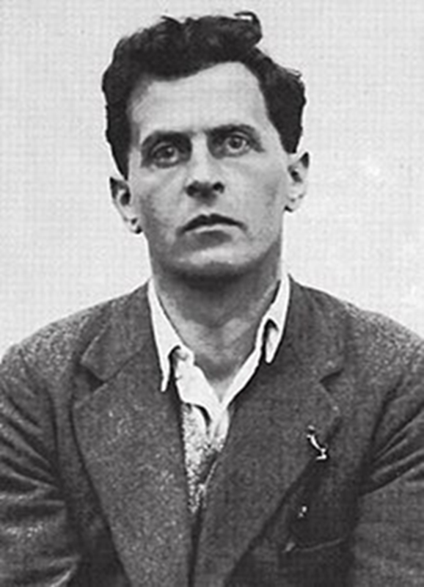
Ludwig Josef Johann Wittgenstein 26 April 1889 – 29 April 1951) was an Austrian philosopher who worked primarily in logic, the philosophy of mathematics, the philosophy of mind, and the philosophy of language

Slide 5
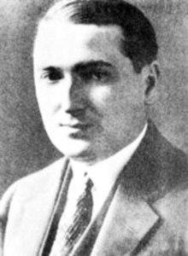
Emil Leon Post (/poʊst/; February 11, 1897 – April 21, 1954) was a Polish-born American mathematician and logician. He is best known for his work in the field that eventually becameknown as computability theory. known as computability theory

Slide 6
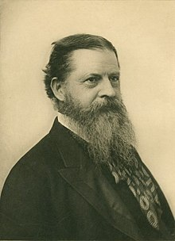
Charles Sanders Peirce
(/pɜːrs/,^{[10][11]} PURSS; September 10, 1839 – April 19, 1914) was an American philosopher, logician, mathematician, and scientist who is sometimes known as "the father of pragmatism". He was educated as a chemist and employed as a scientist for thirty years. Today he is appreciated largely for his contributions to logic, mathematics, philosophy, scientific methodology, semiotics, and for his founding of pragmatism.

Slide 7
1Unary operations
1.1Logical true
1.2Logical false
1.3Logical identity
1.4Logical negation
2Binary operations
2.1Truth table for all binary logical operators
2.2Logical conjunction (AND)
2.3Logical disjunction (OR)
2.4Logical implication
2.5Logical equality
2.6Exclusive disjunction
2.7Logical NAND
2.8Logical NOR
3Applications
3.1Truth table for most commonly used logical operators
3.2Condensed truth tables for binary operators
3.3Truth tables in digital logic
3.4Applications of truth tables in digital electronics

Slide 8
https://www.youtube.com/watch?v=SRzSZ_rEE_A

Slide 9
THANK YOUR ATTENTION

